Slide 1
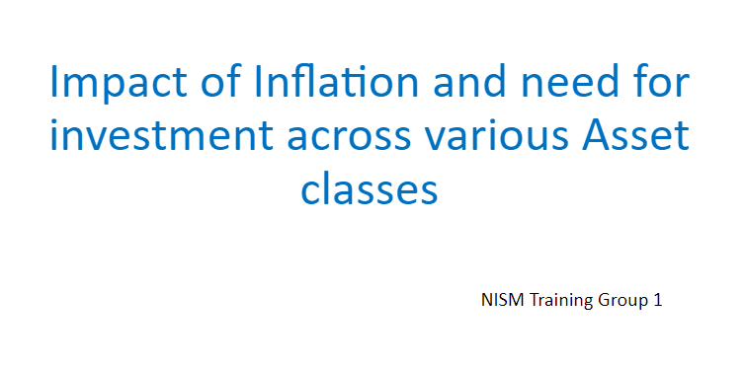

Slide 2
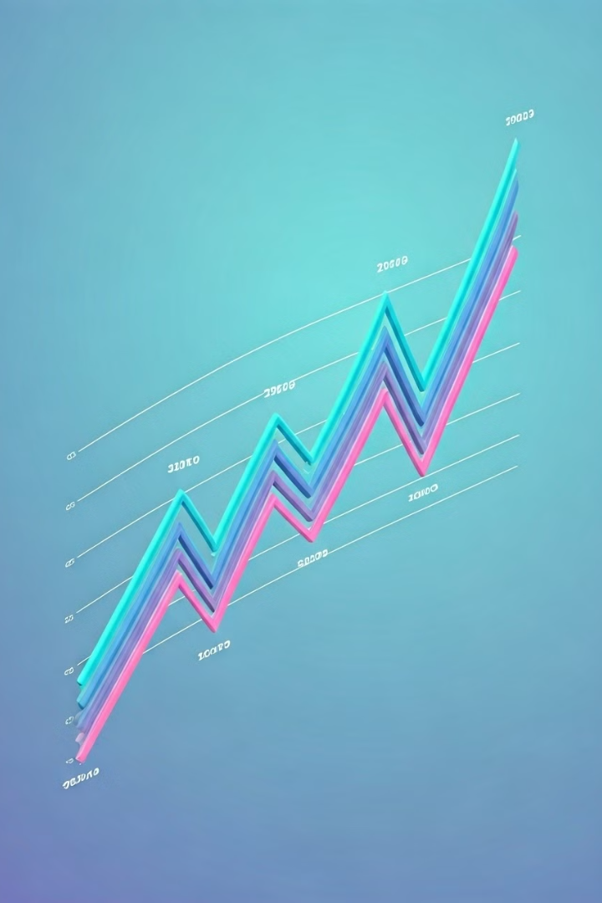
Understanding Inflation and Its Impact
Inflation is a crucial economic factor that significantly affects our daily lives. Understanding its impact is essential for making informed financial decisions. We will explore the various effects of inflation and discuss strategies for mitigating its impact on your investments.

Slide 3


Erosion of Purchasing Power
Inflation erodes the value of your money over time. As prices rise, your purchasing power declines. This means you can buy less with the same amount of money. This trend significantly affects the value of your savings and investments.
Decreased Spending Power
Income Inequality
Higher inflation can lead to a reduction in consumer spending, as individuals face increasing costs for essential goods and services.
Inflation can disproportionately impact low-income households, further exacerbating wealth disparities.
Economic Uncertainty
High inflation creates economic uncertainty, which can hinder business investment and economic growth.

Slide 4
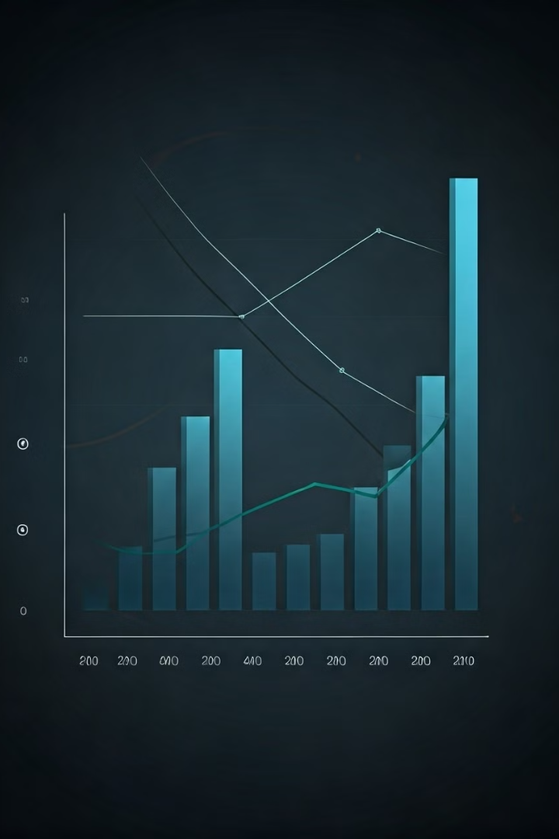
Declining Real Rates of Return
Inflation reduces the real return on your investments. As inflation increases, the rate of return on your investments needs to be higher than the inflation rate to maintain your purchasing power.
1
Decreased Return on Savings
2
Reduced Investment Returns
The return on your savings accounts may not keep pace with inflation, leading to a loss of purchasing power.
The returns on stocks, bonds, and other investments may be lower than expected after adjusting for inflation.
3
Negative Real Returns
4
Impact on Retirement Planning
In extreme cases, inflation can outpace investment returns, leading to negative real returns.
Inflation can erode the value of retirement savings, making it harder to reach financial goals.

Slide 5
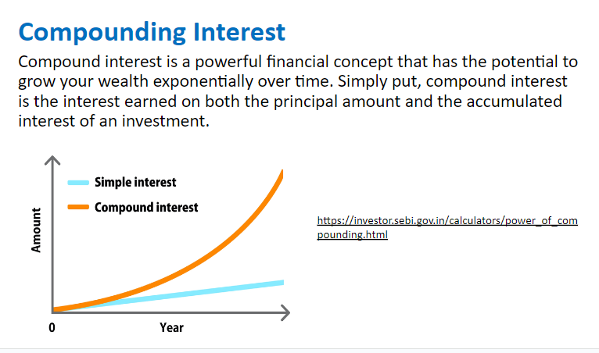

Slide 6
Importance of Asset Diversification
Diversification involves spreading your investments across different asset classes to reduce risk. In an inflationary environment, diversification helps mitigate the impact of inflation and protect your portfolio from significant losses.
Reduce Risk
Manage Volatility
Enhance Returns
Diversification helps you avoid putting all your eggs in one basket, reducing the risk of significant losses if one asset class performs poorly.
Different asset classes have varying levels of volatility, and diversification can smooth out portfolio fluctuations over time.
Diversification can potentially enhance returns by allocating investments to asset classes that perform well in different economic environments.

Slide 7





Exploring Bond and Debenture
Bonds and debentures are fixed-income securities that offer regular interest payments and a return of principal at maturity. In an inflationary environment, investors may seek higher-yielding bonds to compensate for inflation.
Bond Yields
Inflation-Indexed Bonds
Bond yields tend to rise in an inflationary environment as investors demand higher returns to compensate for the erosion of purchasing power.
Inflation-indexed bonds, such as Treasury Inflation-Protected Securities (TIPS), provide protection against inflation by adjusting their principal value based on inflation.
High-Yield Bonds
Floating Rate Bonds
High-yield bonds, also known as junk bonds, offer higher interest rates but carry a greater risk of default. They may be attractive in an inflationary environment but require careful consideration.
Floating rate bonds offer interest payments that adjust based on a reference rate, providing a degree of protection against rising interest rates.

Slide 8




Role of Real Estate in Portfolios
Real estate is a tangible asset class that can provide a hedge against inflation. As inflation rises, the value of real estate tends to increase, providing potential capital appreciation and income from rental income.
Property Appreciation
Real estate values often rise in line with inflation, offering protection against the erosion of purchasing power.
Rental Income
Rental income can provide a steady stream of cash flow that helps offset the effects of inflation on your purchasing power.
Inflation Hedge
Real estate is considered a good inflation hedge, as its value tends to rise alongside inflation.

Slide 9

Investing in Equities for Growth
Equities, or stocks, represent ownership in companies. In an inflationary environment, companies may be able to pass on higher costs to consumers, potentially leading to higher earnings and stock price appreciation.
Value Stocks
Tend to perform well during periods of high inflation as they are undervalued by the market.
Growth Stocks
May face headwinds during high inflation as investors may seek value stocks.
Dividend Stocks
Provide a steady stream of income, which can help offset the effects of inflation on your purchasing power.

Slide 10

Commodities as Inflation Hedge
Commodities are raw materials, such as gold, oil, and agricultural products. Historically, commodities have been considered a hedge against inflation as their prices tend to rise when inflation is high.
1
Gold
Gold is considered a safe-haven asset that holds its value during times of economic uncertainty and inflation.
2
Energy
Oil and natural gas prices can rise in an inflationary environment as demand for energy increases.
3
Agricultural Commodities
Food prices can rise due to factors such as supply chain disruptions, weather events, and rising energy costs.

Slide 11

Conclusion and Key Takeaways
Understanding the impact of inflation is crucial for managing your finances effectively. Asset diversification is essential to mitigate the effects of inflation on your investments and build a resilient portfolio.
1
Diversification
2
Inflation-Indexed Securities
Invest across different asset classes to mitigate risk and potentially enhance returns.
Consider investing in inflation-indexed bonds to protect your principal from the erosion of purchasing power.
3
Real Estate
4
Commodities
Real estate can provide a hedge against inflation through potential appreciation and rental income.
Commodities, such as gold, can act as a safe-haven asset and a hedge against inflation.

Slide 12

Thanks to all
Thank you for your attention.
We hope this presentation has provided you with valuable insights into the impact of inflation and strategies for investing in various asset classes.

